Slide 1
Improving object detection for Infrared images using YOLO
Emil Vardar, Fanxuan Liu, Qian Zhou, Xiaolong Sun, Yutong Jiang
Project owner: Meng Zhang

Slide 2
Overview
Background of object detection for infrared image
Background of YOLO
Proposals of object detection for infrared image based on YOLO
Timeline

Slide 3
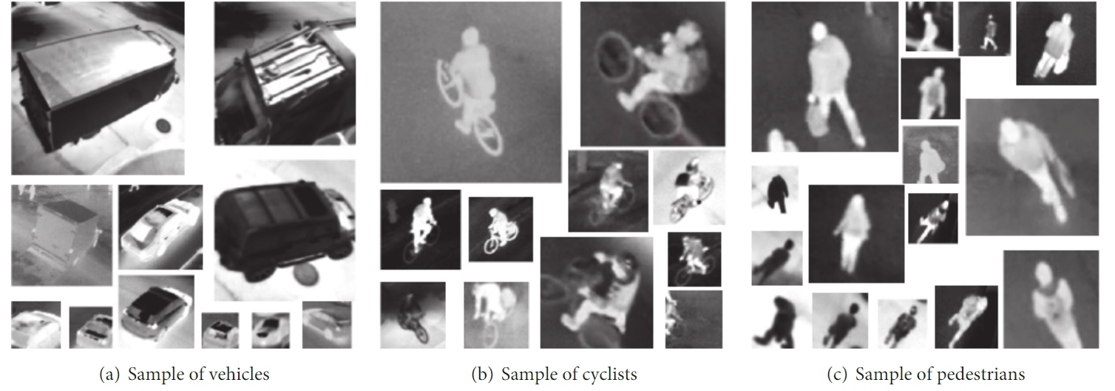
Object detection for Infrared (IR) Image
IR images are images captured with infrared light
Not distinguished in the shape and boundary
The resolution is lower compared to RGB images
Contain much more noise (e.g.Gaussian noise)
Sensitive to temperature changes
Notes:
Object detection in infrared images has received extensive attention within the field of computer vision due to its important research value for applications. Although object detection models have achieved promising results in various tasks, it is still a challenging task in infrared images, as most models only focus on visible images.)
Infrared target detection is a hot topic in object detection due to its specific characteristics and special demands. The infrared images have some inherent defects; for instance, infrared targets captured by the infrared cameras are not distinguished in the shape and boundary, which is easily to be misclassified by the environment information; secondly, compared with the visible images, the infrared images contain much more noise such as the Gaussian noise, which may depress the detection accuracy, if not preprocessed. Also, the infrared images more sensitivity to temperature changes in the environment compared with those characteristics of visible images.What is more, as for the infrared remote sensing targets, the pixels are much smaller than the ordinary images. All of these features make the infrared target detection more challenging than the normal detection tasks.

Slide 4
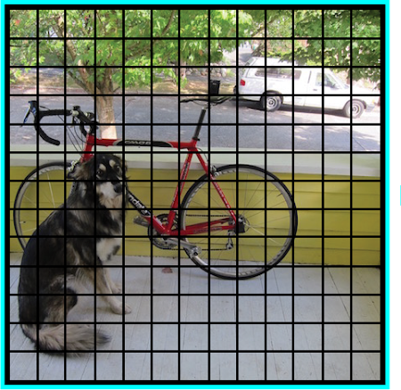
You Only Look Once v1 (YOLO)
YOLO is state-of-the-art object detection algorithm for RGB images.
Concept behind YOLO:
It parses the input image to smaller grids cells each of the same size
Assume NxN smaller grids
Each grid detects objects within itself
The image is feed through a Convolutional Neural Network (CNN)
The CNN outputs a tensor of size NxNxKxB
[1]
Notes:
Background for YOLO

Slide 5
What is K and B?
There will be a vector output for each NxN grid cell in the input image.
This vector will have K entries. This entries are:
[]
p_c → The probability of any object ‘center’ being in this grid cell
b_x → Center for the bounding box in ‘x’ axis
b_y → Center for the bounding box in ‘y’ axis
b_h → The height of the bounding box
b_w → The width of the bounding box
c_1 → If class 1 is the object in the corresponding grid cell return 1 else 0
…
c_M → M number of class
There are usually B bounding box per grid cell → Hence B of these vectors

Slide 6
There are YOLO v1-v7
There are many different YOLO versions out there
All of them are based on the principle above
But they differ in small things such as:
YOLO v3 and onwards uses Backbone, neck, head architecture
YOLO v3 make use of Residual architecture and skip connections
YOLO v4 uses Cross BN, Self-adversarial training
...
We are planning on using YOLO v5
YOLO v5 is pretrained on the COCO dataset

Slide 7
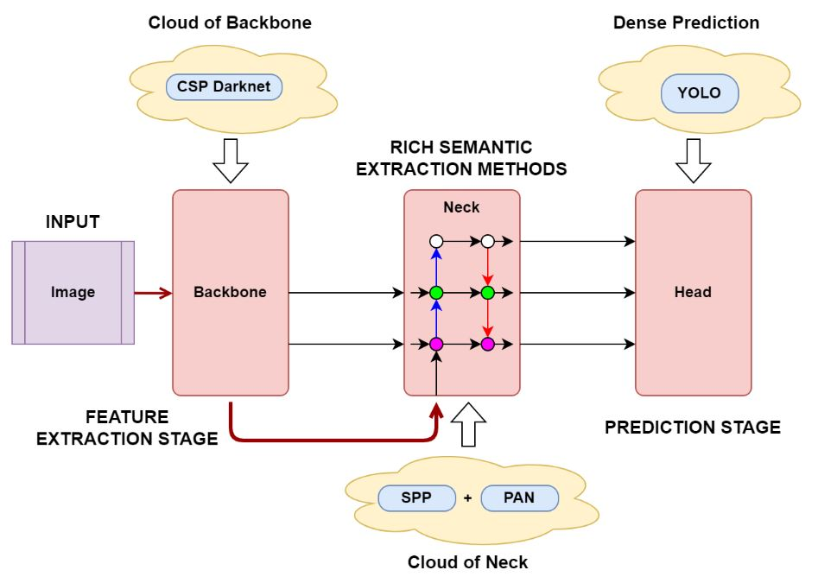
[3]
Notes:
We will have a lot of options on changing the Backbone-Neck-Head architecture
Background 3-3.5 minutes → Emil

Slide 8
Introduction to the project
Target:
Design and build a YOLO-based network to detect objects for infrared images
Improve the network to increase its accuracy and balance the accuracy and speed
Dataset:
Multispectral Pedestrian Benchmark
Teledyne FLIR Thermal Dataset

Slide 9
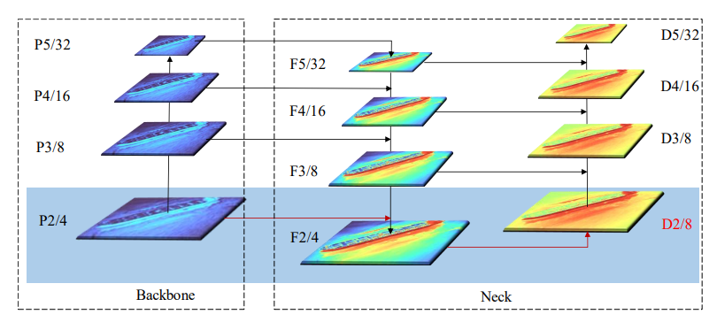
Proposed ideas — add P2 feature map layer
Problem description: For tiny targets, features compressed by 8-time downsampling are extremely weak and may even disappear completely.
Solution: Add a high-resolution feature map with a 4-time downsampling
Notes:
Originally, yolo v5 uses 8-time downsampled feature maps to detect small objects.But the target features compressed by 8-time downsampling are extremely weak and may even disappear completely for tiny targets. so we add a high-resolution feature map with a 4-time downsampling to detect tiny targets. First, the feature map P2 extracted by the backbone network is fused with feature maps of other scales. Then, a D2 detection head is constructed using the fused F2 features, so that the network can utilize more location information and feature information of small objects provided by the high-resolution feature layer P2

Slide 10
Proposed ideas — dilation and sub-pixel conv
Apply dilation convolution and sub-pixel convolution
Problem description: Infrared images have low resolution
Solution: Use a mixed convolutional layer combining dilated convolutions, subpixel convolutions and standard convolutions to extract the multi-grained features.
Notes:
https://www.sciencedirect.com/science/article/pii/S0925231219314341

Slide 11
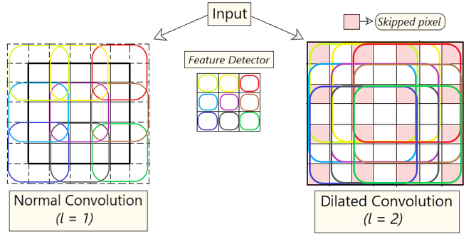
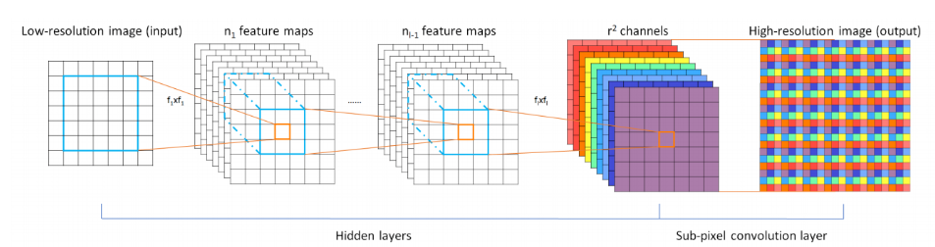
Proposed ideas — dilation and sub-pixel conv
Dilation convolution:
Sub-pixel convolution:
Notes:
Dilation convolution enlarges the receptive field and extracts the coarse-grained information without additional computational complexity. expand the kernel (input) by inserting holes between its consecutive elements. In simpler terms, it is the same as convolution but it involves pixel skipping, so as to cover a larger area of the input.
Sub-pixel convolution fuses multi-channel features to extract the sub-pixel information and reposition the features in pixel level. change the shape from n*n*(c*r^2) to nr*nr*c to improve the computational efficiency and recover a high-resolution image from its low-resolution counterpart.

Slide 12
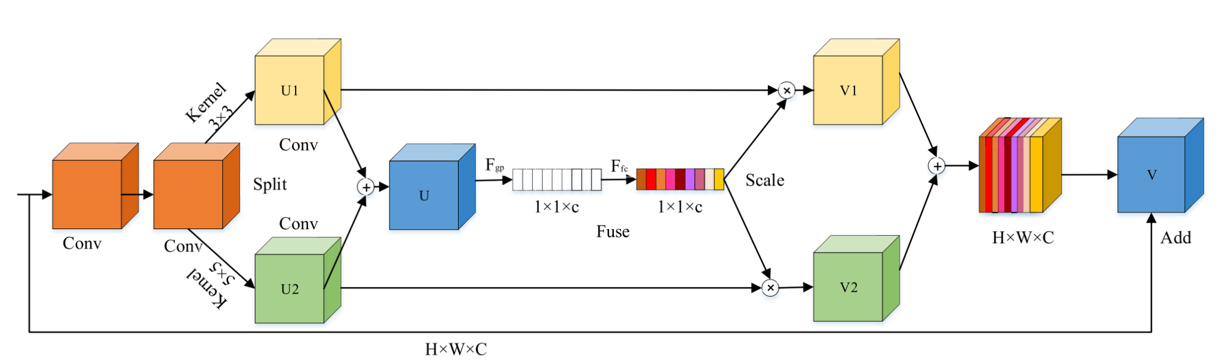
Proposed ideas — Attention-based YOLO
Problem description: We should pay more attention to the shallow and detailed features in infrared images.
Solution: Introduce an improved SK attention module in each CSP module and use two convolutional operations with different convolution kernel sizes to learn the channel weights.
Notes:
v

Slide 13
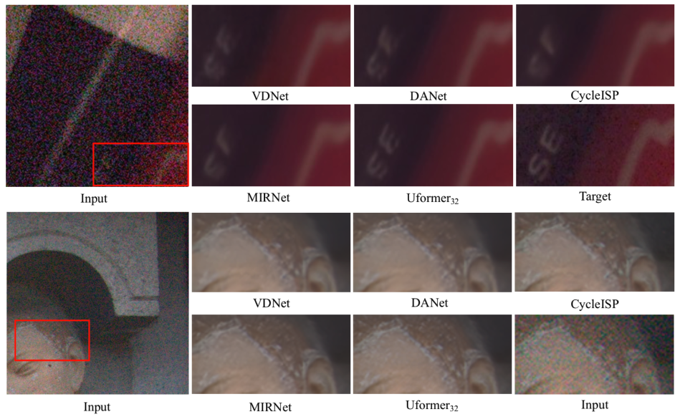
Proposed ideas — Combination
General Methods: 1. Combine image restoration and object detection
2. Embed image restoration in YOLO-based architecture
Image restoration: Uformer (Transformer-based architecture)
Object detection: Basic YOLO-based architecture
Potential problem:
Tradeoff between accuracy and speed
Reference: Uformer: A General U-Shaped Transformer for Image Restoration
Notes:
https://github.com/ultralytics/yolov5/issues/6998

Slide 14
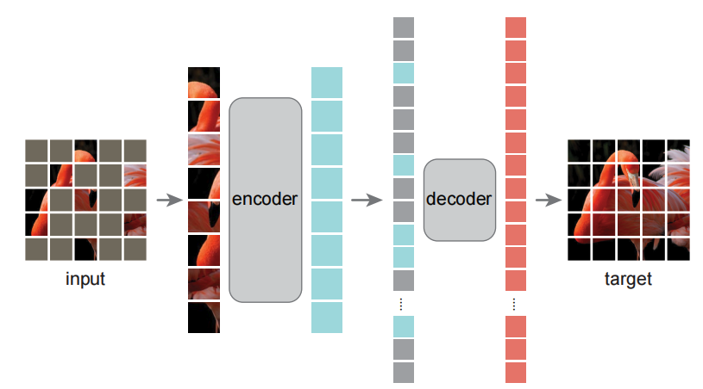
Proposed ideas — masked autoencoder
General Methods: Combine masked autoencoder with YOLO
Process: 1. Randomly mask the input image and train the model to get the reconstruction
2. fine-tune the encoder
Advantages:
Remove redundancy by masking pixels and increase the speed
Problem:
It requires higher computational power
Find an efficient way to combine MAE and YOLO

Slide 15
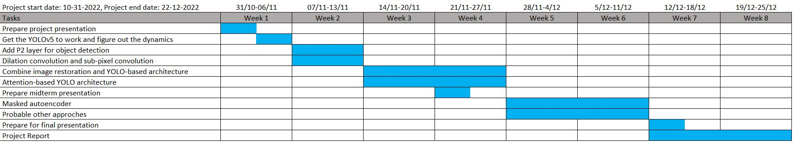
Timeline
Notes:
Build YOLO-based architecture for object detection (1 week)
Improve the network to increase the accuracy
a. add P2 layer for object detection (1 week group 1)
b. dilation convolution and sub-pixel convolution (1 week group 2)
c. combine image restoration and YOLO-based architecture (2 weeks group 1)
d. attention-based YOLO architecture (2 weeks group 2)
e. masked autoencoder (2 weeks)
Project Report (2 weeks)

Slide 16
References
[1] https://www.v7labs.com/blog/yolo-object-detection
[2] Thuan D., Evolution of Yolo algorithm and Yolov5: The State-of-the-Art object detection algorithm[J]. 2021
[3] https://wikidocs.net/167833
[4] Ye J, Yuan Z, Qian C, Li X. CAA-YOLO: Combined-Attention-Augmented YOLO for Infrared Ocean Ships Detection. Sensors. 2022; 22(10):3782. https://doi.org/10.3390/s22103782
[5] Guan, J. et al. (2019) Fixed pattern noise reduction for infrared images based on cascade residual attention CNN, Neurocomputing. Elsevier. Available at: https://www.sciencedirect.com/science/article/pii/S0925231219314341 (Accessed: October 31, 2022).
[6] Wang Z, Cun X, Bao J, et al. Uformer: A general u-shaped transformer for image restoration[C]//Proceedings of the IEEE/CVF Conference on Computer Vision and Pattern Recognition. 2022: 17683-17693.

Slide 17
References
[7] Li S, Li Y, Li Y, et al. YOLO-FIRI: Improved YOLOv5 for Infrared Image Object Detection[J]. IEEE Access, 2021, 9: 141861-141875.
[8] He K, Chen X, Xie S, et al. Masked autoencoders are scalable vision learners[C]//Proceedings of the IEEE/CVF Conference on Computer Vision and Pattern Recognition. 2022: 16000-16009.

